Slide 1
E-Ration Shop
Application Development Project
Guide: Dr.K.Srikanth sir
Group – 23
Jonathan Abhishek Rao. T 2011CS030076
K Sandeep Kumar 2011CS030034
K Anurag Teja 2011CS030084

Slide 2
ABSTRACT
E-Ration shop is a Government-backed entity which would sell ration products online. It mainly focuses on providing rations at the availers’ doorstep without much hassle along with proper and transparent stock keeping as the goods are directly shipped from godowns to the customers’ doorstep.
At the moment there is no online system being implemented to further supervise the process of monthly rations and without an online solution the customers are faced with the problem of waiting in long queues, bargaining and some non-suspecting rationers being cheated by the shop owner .
Implementing an online shop system would greatly benefit the Government as well as the customer by maintaining full transparency of the items available and their quantities.

Slide 3
Issues faced by the public
The task of availing rations from the ration shop is long and tedious. People must wait in long lines to get their rations and sometimes by the time they get their products the shop closes.
Ration shop owners sometimes sell poor quality grains to unsuspecting customers at their shops which lead to health issues and various other problems.
Most ration shops are opened at irregular times creating problems for the people especially the working class.

Slide 4
Main Objective
To provide a simple and easy interface to the customer to access and order the required rations at the comfort of their own homes
The E-Ration shop can be accessed at anytime of the month, without any need of any human participation in the ration shop.
Implementation of this Application will terminate almost all malpractices carried out in the ration shop including:
1. Wrong or inaccurate weight of items being sold
2. Low quality grains being sold
3. Incorrect data entries without customers knowledge

Slide 5
Flow of Webpages
Delivery Team
Login
Register
Manage order details
Delivery status management
Manage profile
Customer
Login
View product
View purchased product
Payment
Manage profile
Message/ Suggestion
Government Admin
Login
Manage ration shop details
Manage product report
Manage customer report
Manage supplier details
Manage ration shop administrator
Ration Shop Admin
Login
Manage profile
Manage customer details
Stock management
Manage ration shop details
Manage order details
Manage products
Manage suppliers

Slide 6
Dependencies used
Software Requirements
HTML & CSS
Java Script
MySQL
IDE: Visual Studio Code
Operating System: Windows
Hardware Requirements
Hard Disk: 120 GB.
Monitor: 15’’ LED
Input Devices: Keyboard, Mouse
Ram: 4 GB.
Any smart device that contains a Web Browser

Slide 7
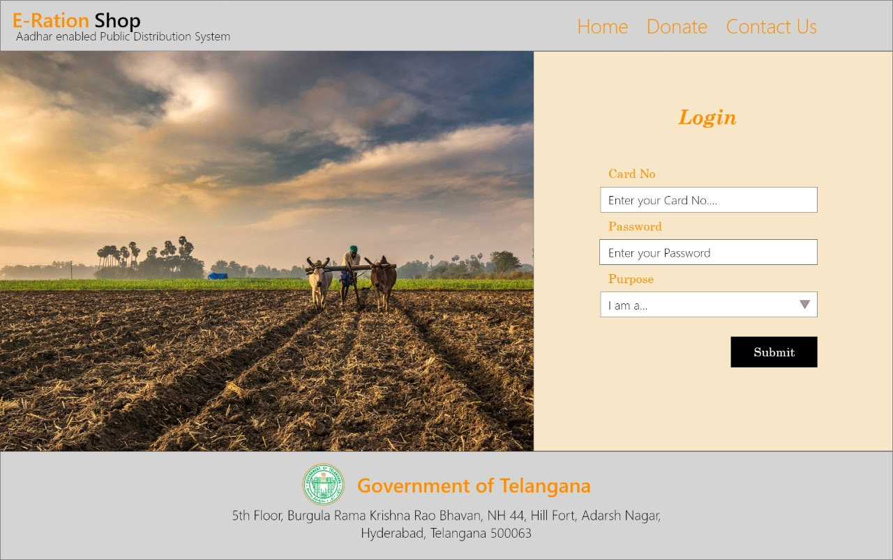
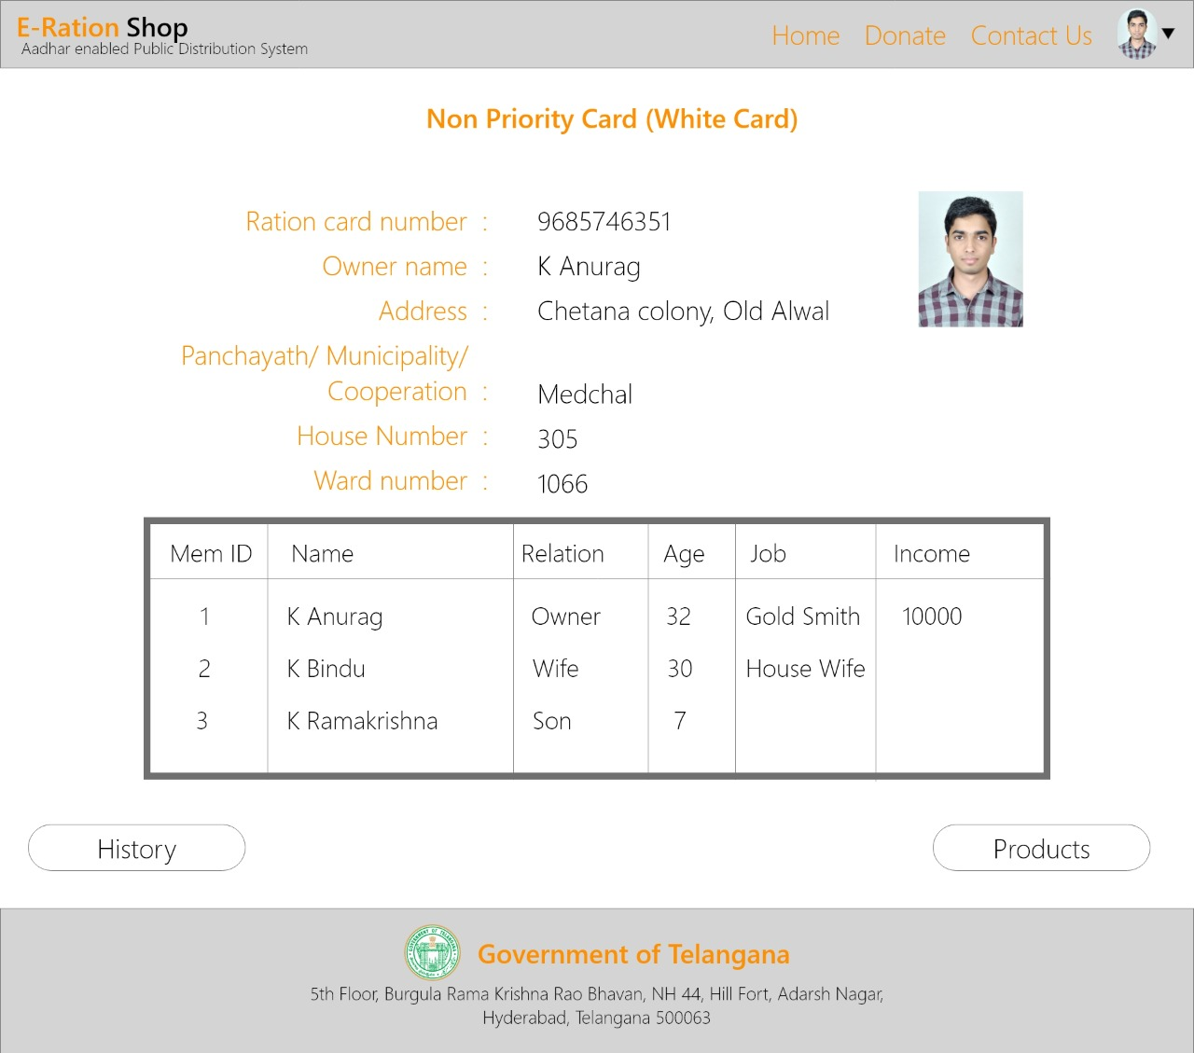
SIMULATION RESULTS

Slide 8
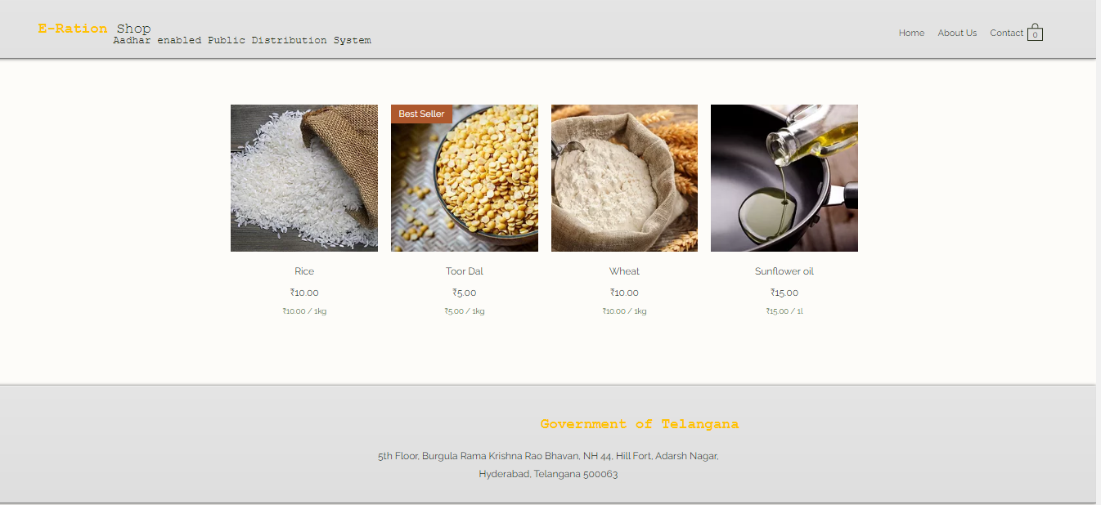
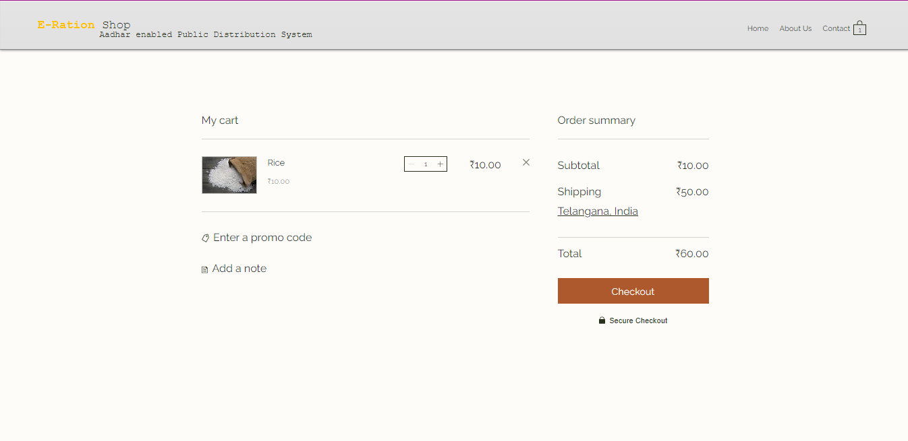

Slide 9
CONCLUSION
Here conclude, this ration shop management system is developed for the ease and usability of the user in purchasing monthly rations via an online platform.
This online system would allow multiple transactions to take place and to be stored in a database which is then viewed by the administrator.
Implementing this system almost entirely removes the need for physical strain on the body by going to ration shops as well as reduces strain on the dealers by implementing computer-based calculations and stock keeping.

Slide 10
Thank You

